Slide 1


OPTIMIZING IN-Situ soil salinity mapping with LANDMAPPER®
Larisa Golovko, PhD
Landviser LLC and RiceTec Inc,
Houston, TX
Presented at
Agricultural Geophysics and Material Properties. Symposium on the Application of Geophysics to Engineering and Environmental Problems 2015: pp. 1-11.
https://doi.org/10.4133/SAGEEP.28-001

Slide 2
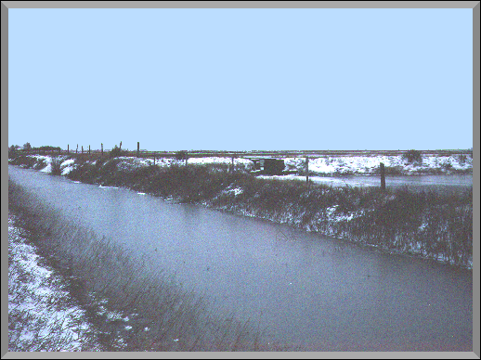
Salinity – persistent problem of irrigated agriculture
Canal seepage

Slide 3
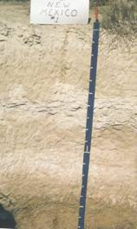
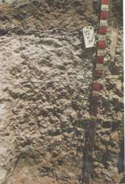
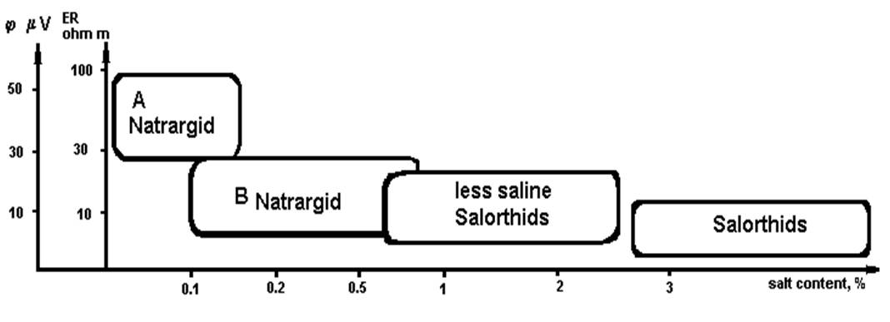
Electrical parameters in soils of arid zone

Slide 4
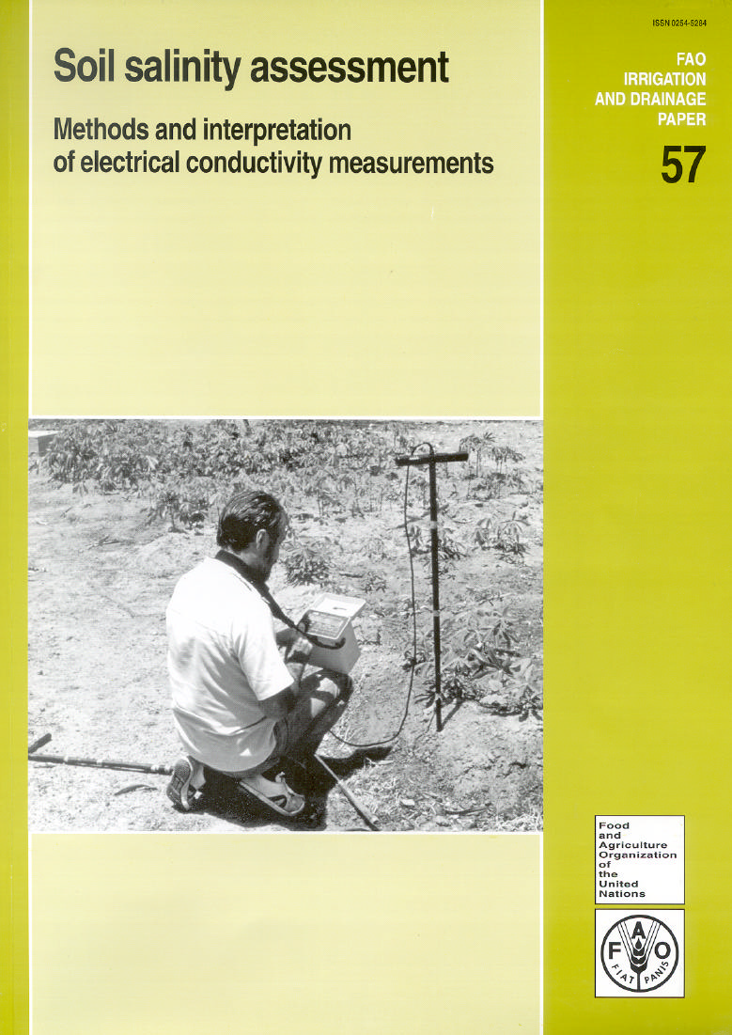
EC/ER direct indicator of total soil salinity
10 Ohm m =1 dS/m = 1 mS/cm =
1 mmho/cm = 640 ppm =
640 mg/L= 0.64 g/L=0.064%.
Notes:
Soil salinity is routinely evaluated in the labs from electrical conductivity of liquid soil saturation extract (ECe). The resulted total salinity is reported either directly in conductivity units (dS/m) or converted to TDS (total dissolved solids) concentration in ppm (parts per million) using formula: 1 dS/m = 1 mS/cm = 1 mmho/cm = 640 ppm = 640 mg/L= 0.64 g/L=0.064%.

Slide 5
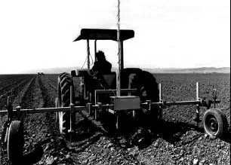
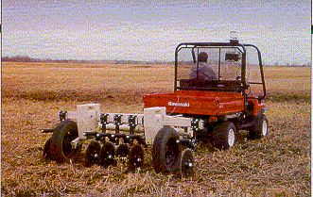
Veris
USDA Salinity Lab

Slide 6
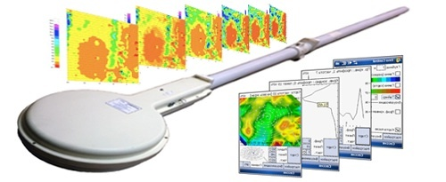
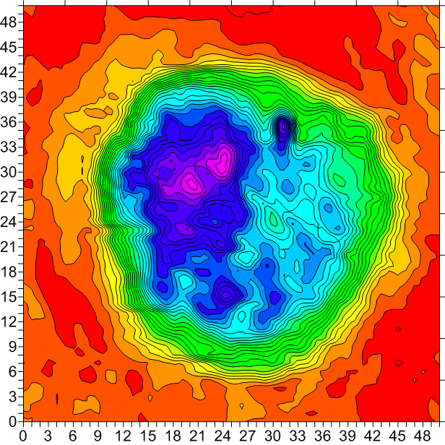
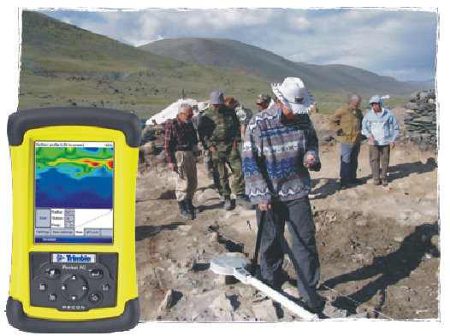
AEMP-14, from KB Electrometry (Russia)
Quick EM method of EC mapping down to 10 m, 14 frequencies.
Other EM Equipment by Dualem, Geonics, GF Instruments, etc.

Slide 7
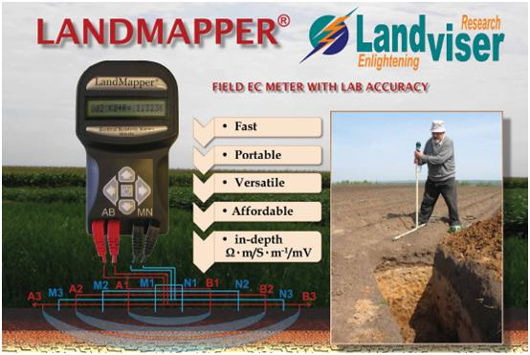
Notes:
As ER an SP techniques are complimentary, Landmapper ERM-02 is a most portable system which combines both measurements in a hand-held design.
Electrical resistivity or conductivity
EC-mapping (four-electrode probe)
vertical electrical sounding (VES) – down to 30 m (100 ft)
Electrical potential
self-potential method (SP)

Slide 8
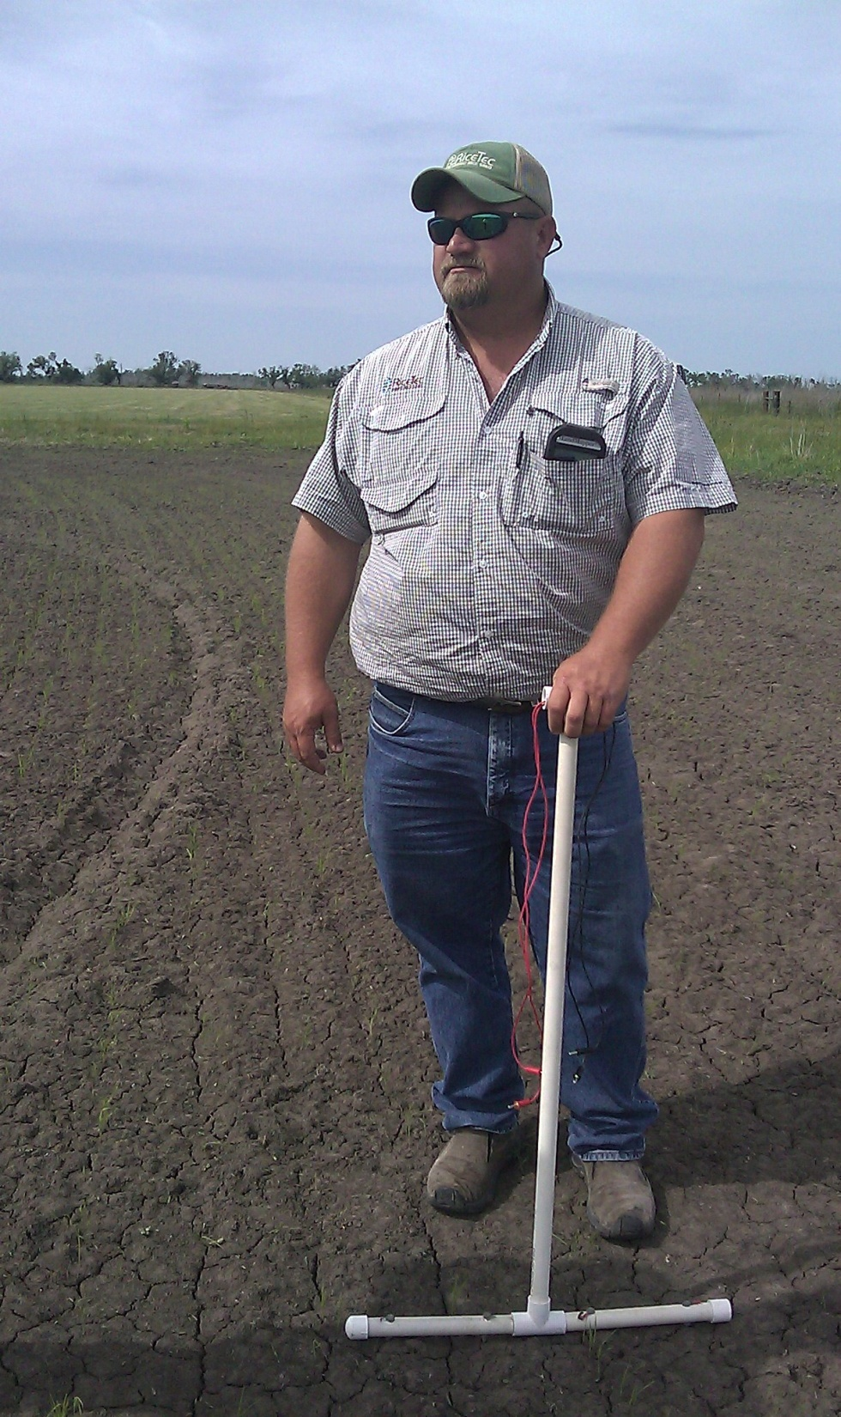
LandMapper® is… Portable and Scalable!
Fits in shirt pocket
Runs all season from standard 9V battery
Measures EC/ER in irrigation water, saturated soil paste as well as in the field soils from 2 cm to ~20 m depth

Slide 9
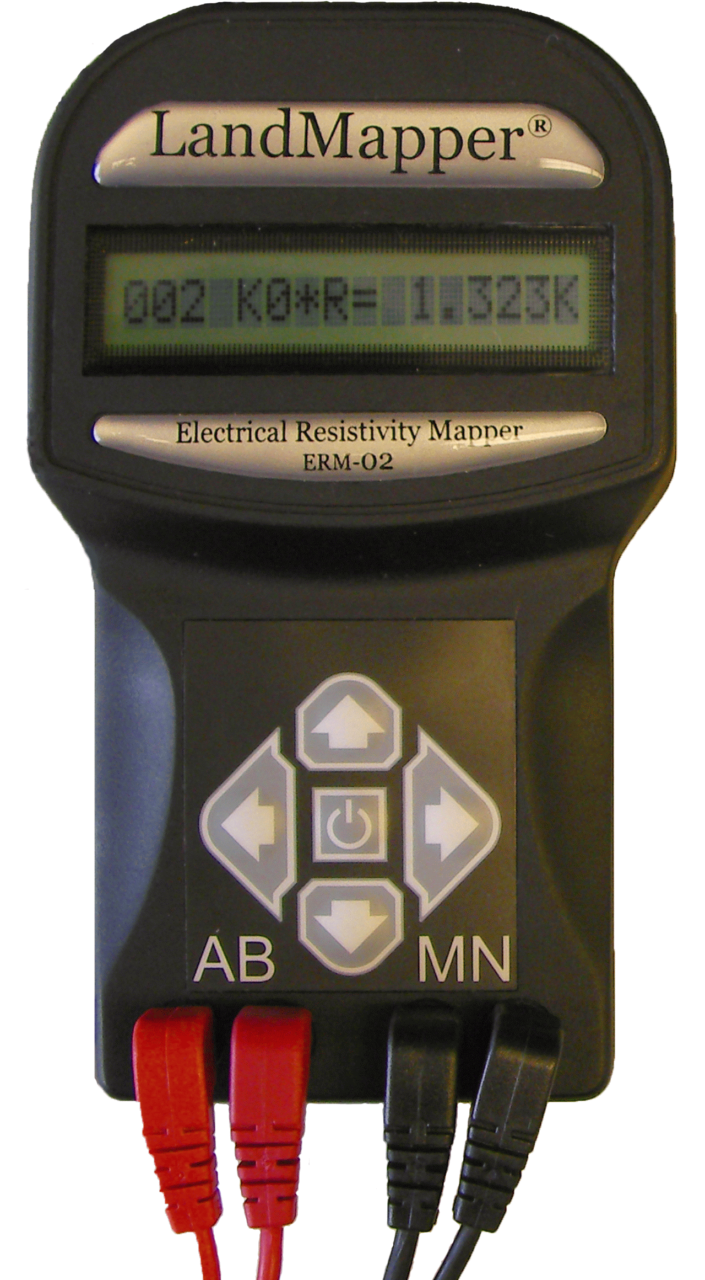
LandMapper® is… Easy and Fast!
No calibration – EC output calibrated once for each probe size.
No GPS integration – no wait for satellite fix
Push one button – get EC value in 4 seconds!
Stores 1000 EC values – can be merged with concurrently taken GPS data to produce quick maps.

Slide 10
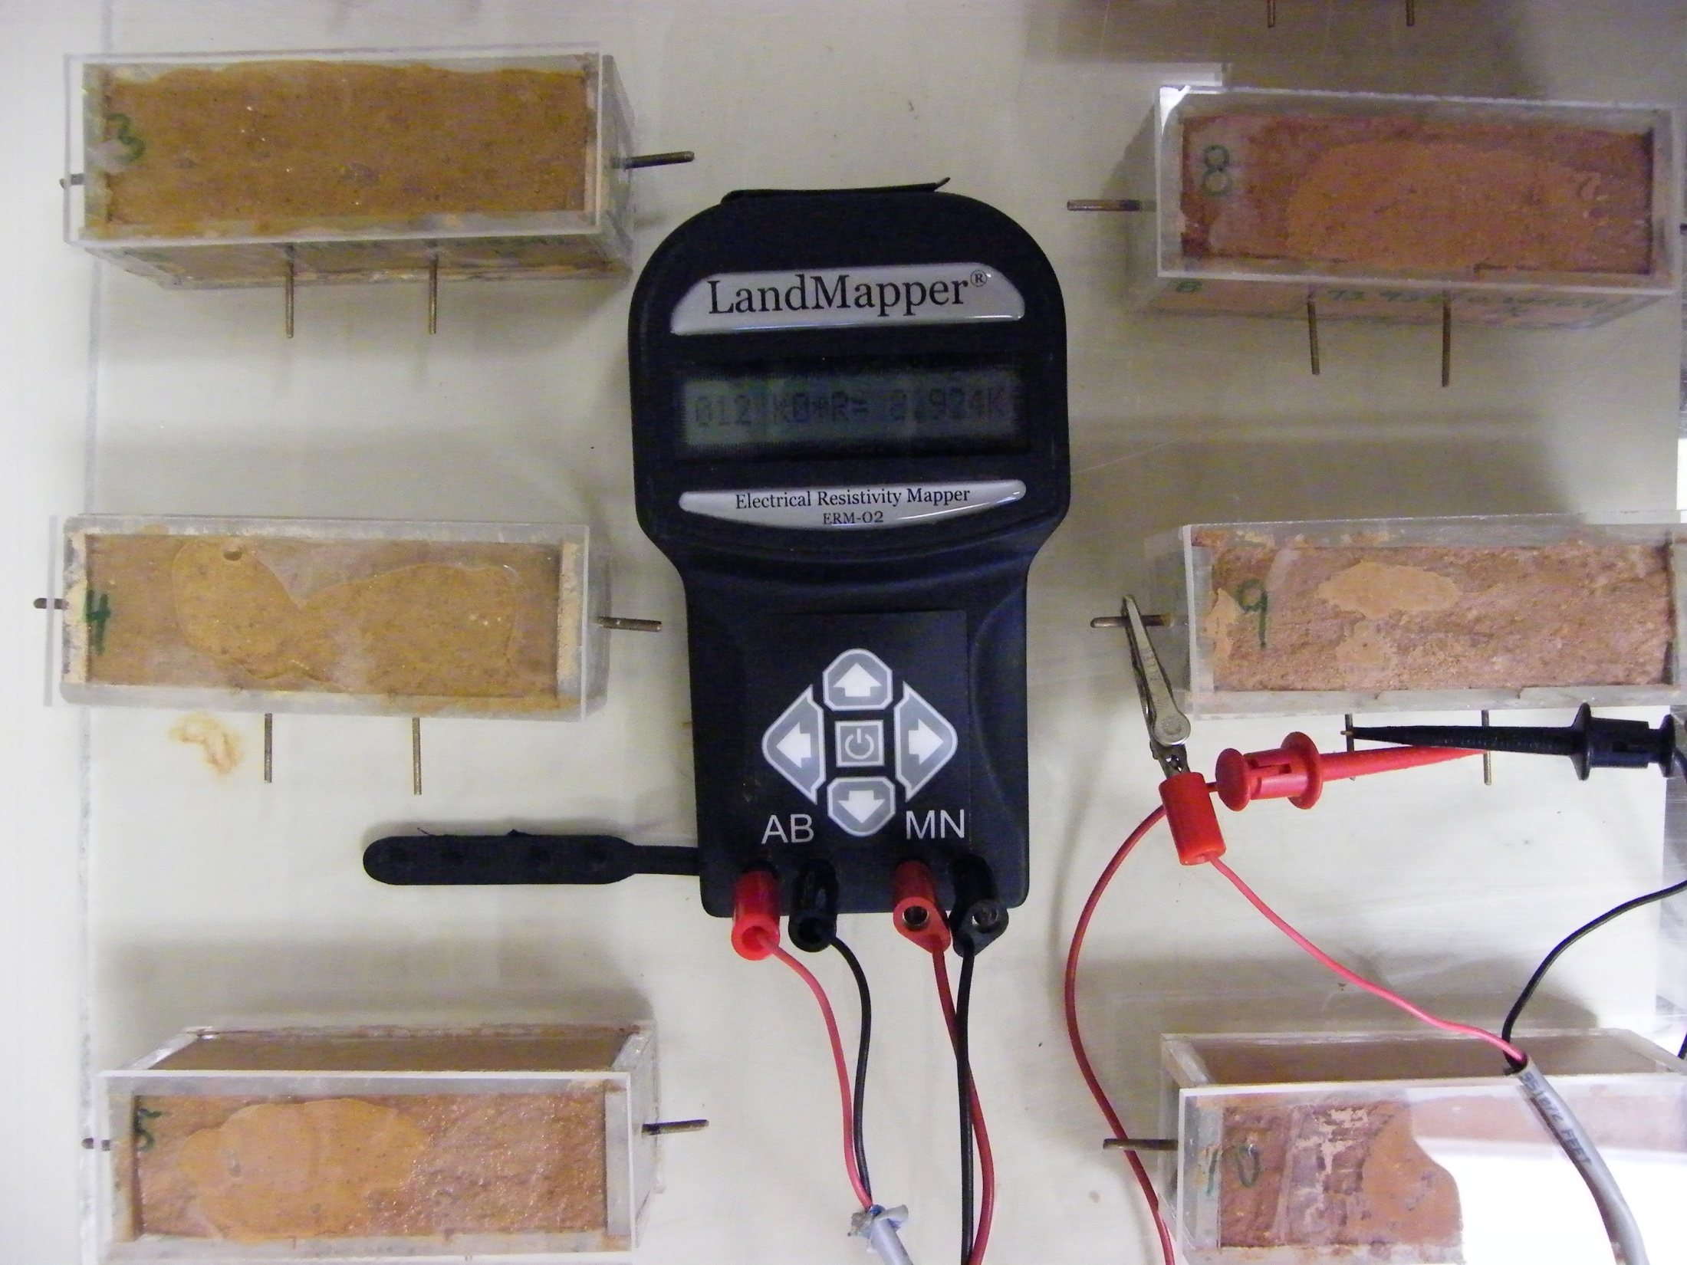
Measuring EC of saturated soil paste in standard four-electrode cells

Slide 11
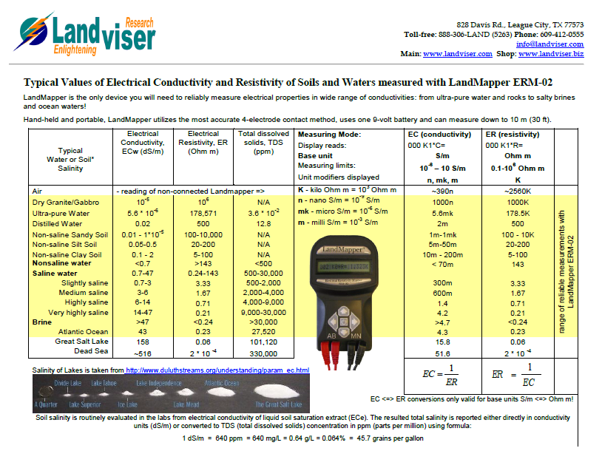

Slide 12
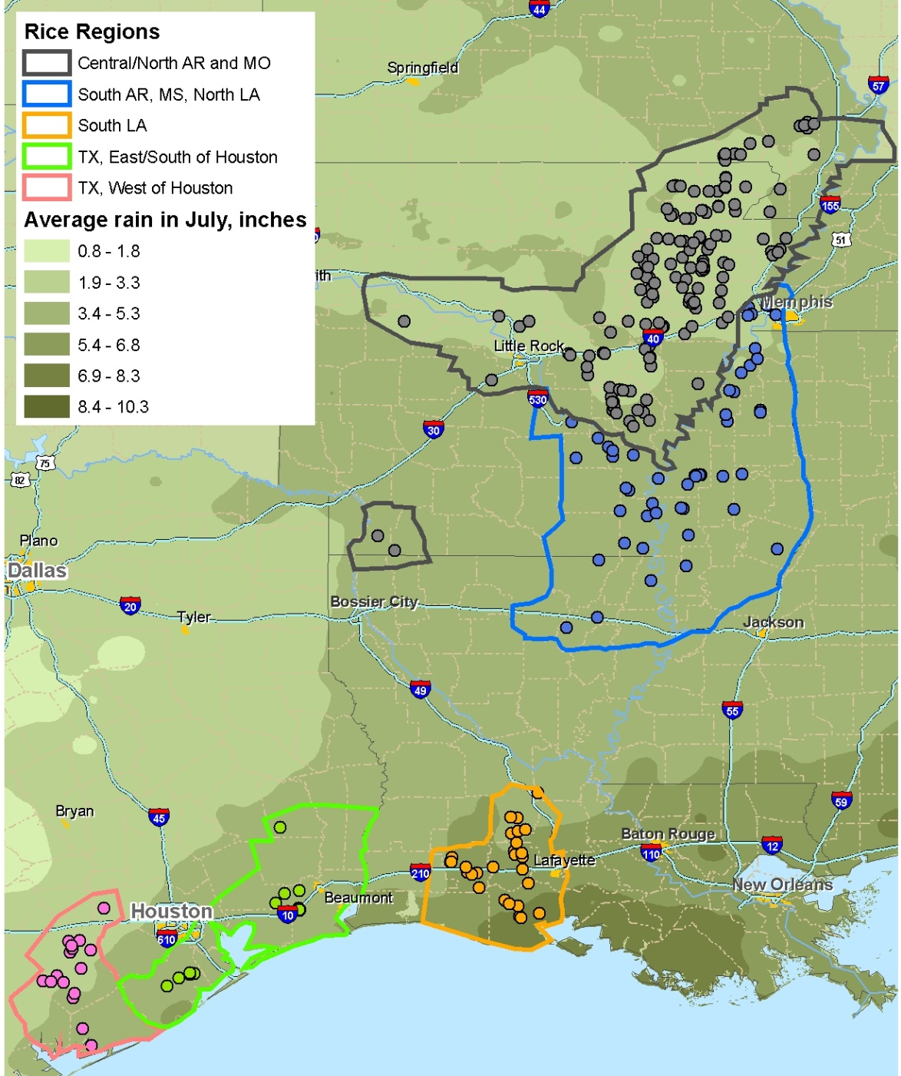
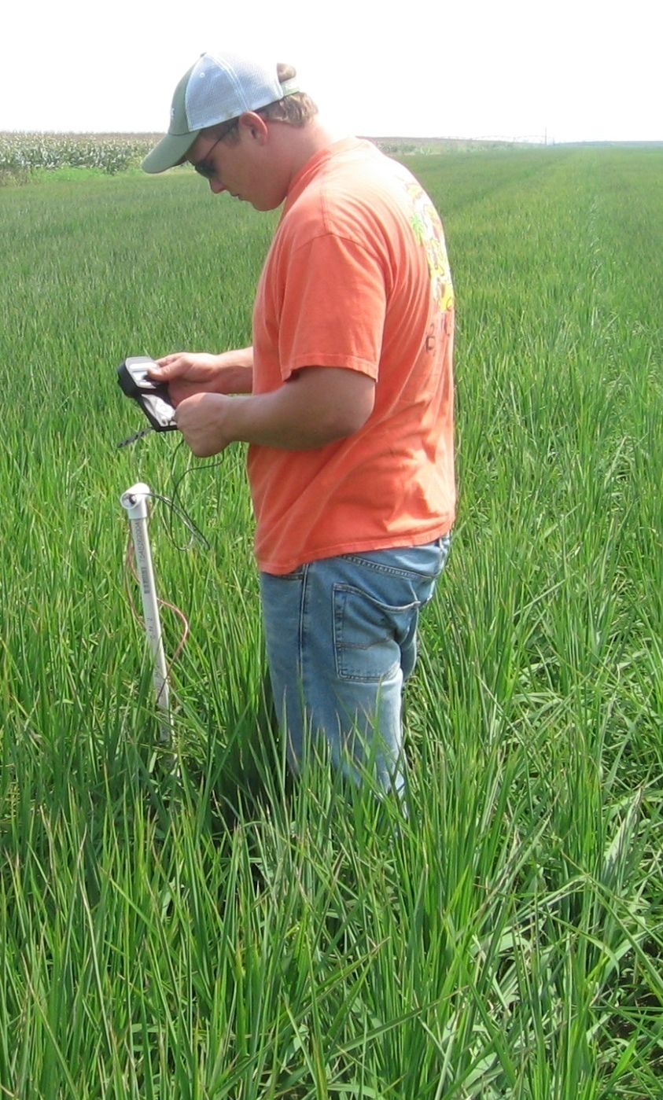

Rice is flooded and flushed

Slide 13
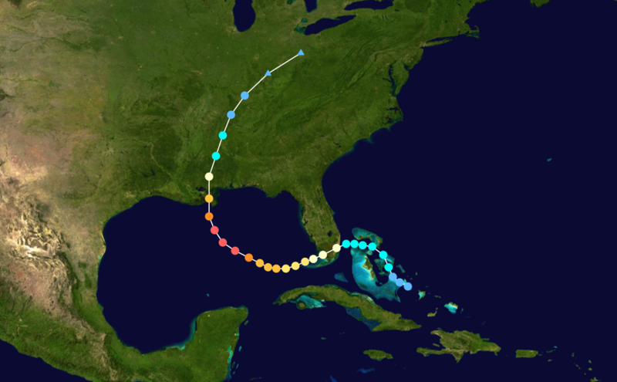
2005 - Katrina

Slide 14
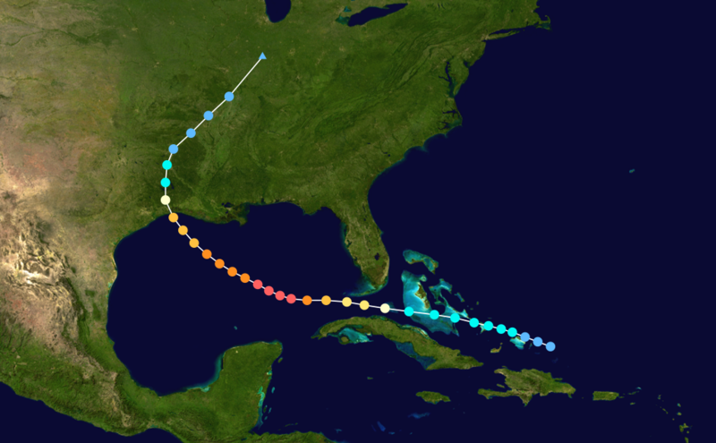
2005 – Rita
.

Slide 15
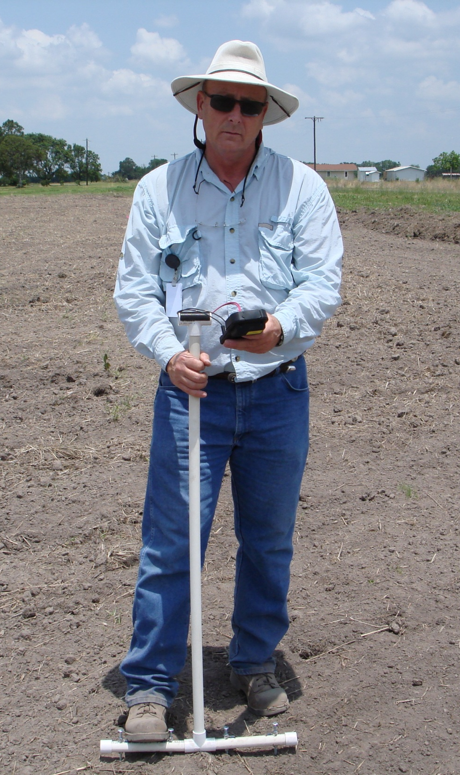
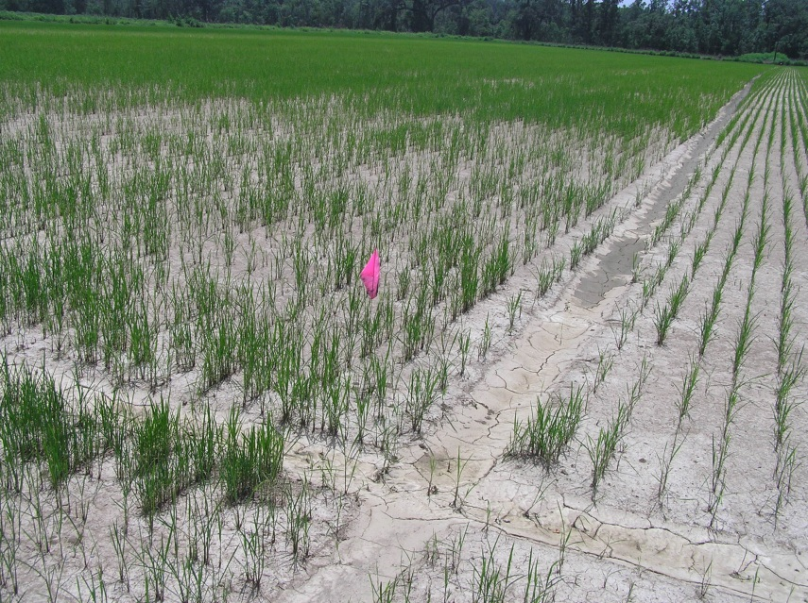
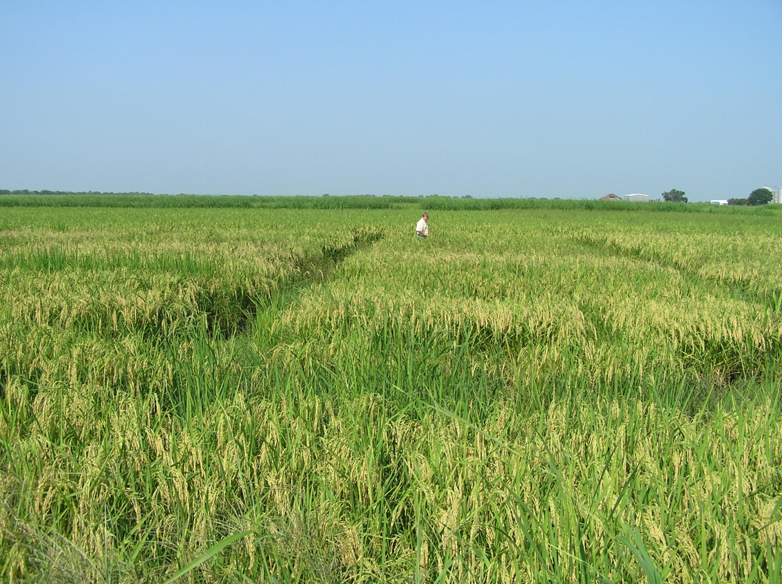
Vermilion Parish Field Plots
Planted hybrids along with varietal checks at the farm.
Variable readings 300 – 1700 ppm in test area

Slide 16
RiceTec Hybrids seem to have better tolerance to salt damage than varieties in field as well
Notes:
Here in red the salinity was well above 1000 ppm and even 3000 in the beginning of the season. Salinity dropped sinificantly but still was above 750 ppm. Nevertheless hybrids gave a decent yield.

Slide 17
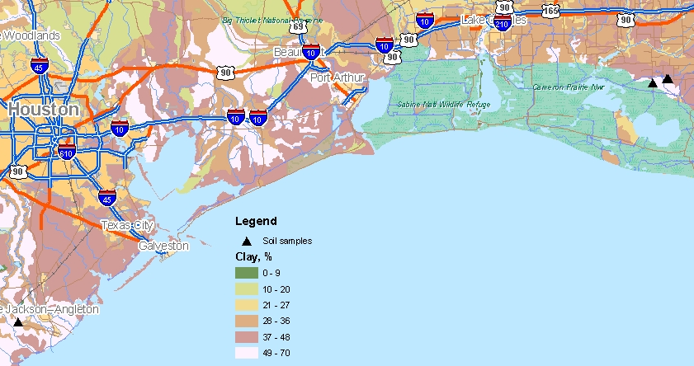
Salinity levels for greenhouse study
No salt | 294 ppm
0.5 gm/kg | 378 ppm
1.0 gm/kg | 302 ppm
1.5 gm/kg | 581 ppm
2.0 gm/kg | 721 ppm
2.3 gm/kg | 1043 ppm
LA soil (check) | 1570 ppm
Notes:
In 2006 growing season, after Rita hit eastern TX and LA shores; RiceTec was looking at hybrid and varietal rice responses to high salt contents in the fields and in greenhouse
GIS helped to select right soils and farms for that study:
Soil affected by saline surge in LA was matched to unaffected soil in TX. Then TX soil was mixed with increasing amount of sea salt to plant rice grow-outs.

Slide 18
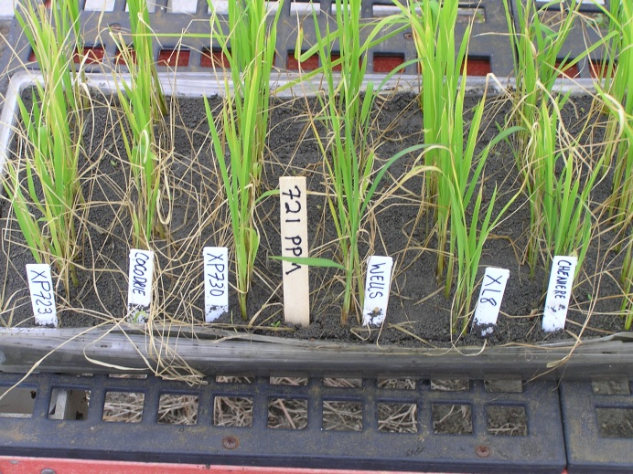
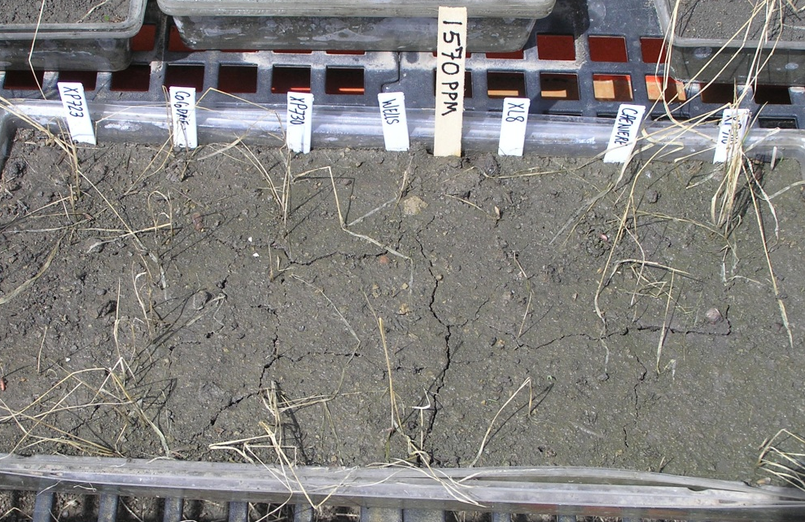
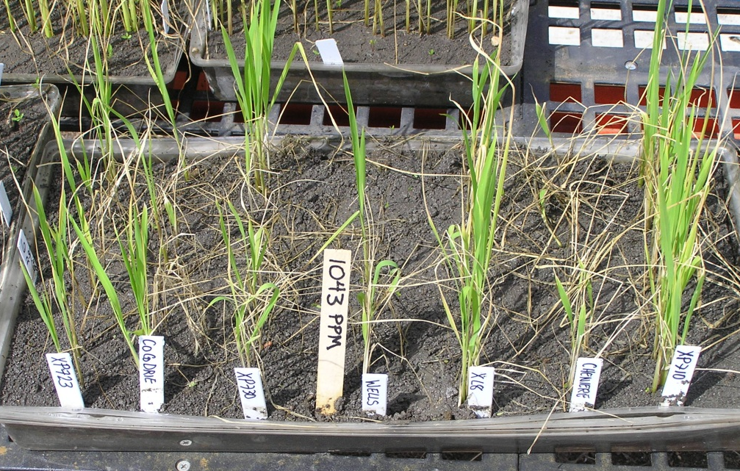

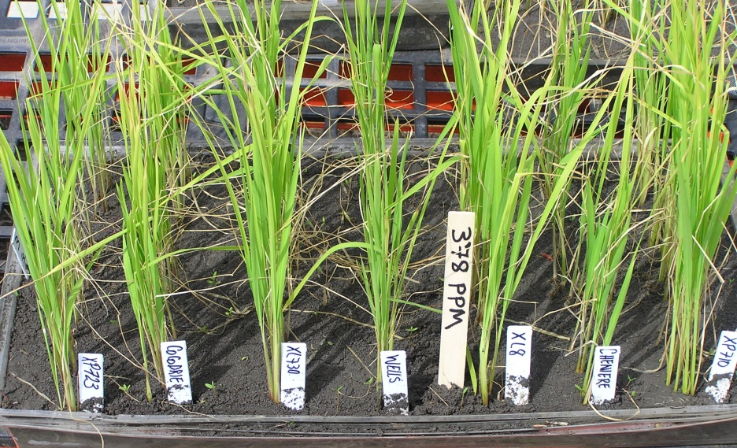
Hybrids can withstand salinity up to 1000 ppm
Notes:
Rice was able to germinate in all flats, but flood killed all in LA soil.

Slide 19
% of Healthy Plants on Flooded Salty Soil

Slide 20
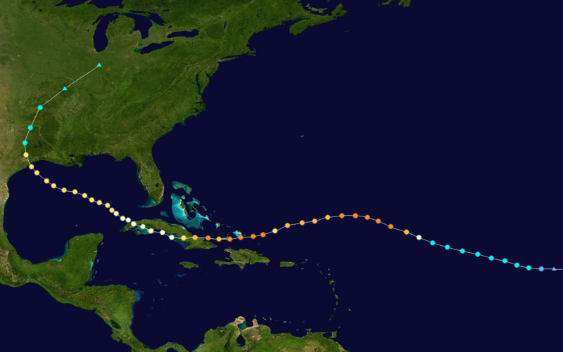
2008 - Ike

Slide 21

Ike – 2 weeks before
AGI-CSA-ASA-SSSA Meeting in Houston

Slide 22
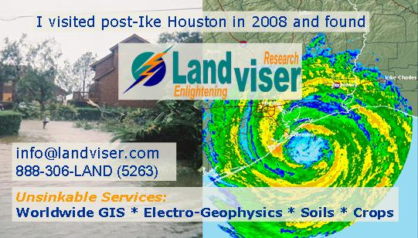
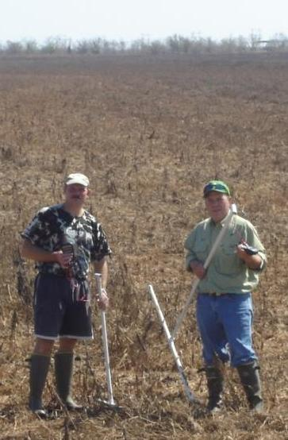
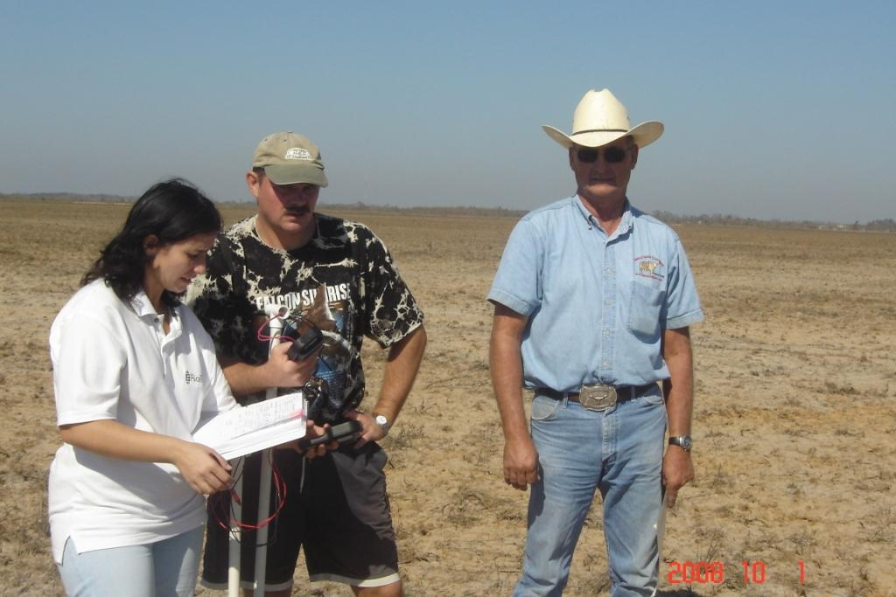
RiceTec reassures farmers hit by storm surge

Slide 23
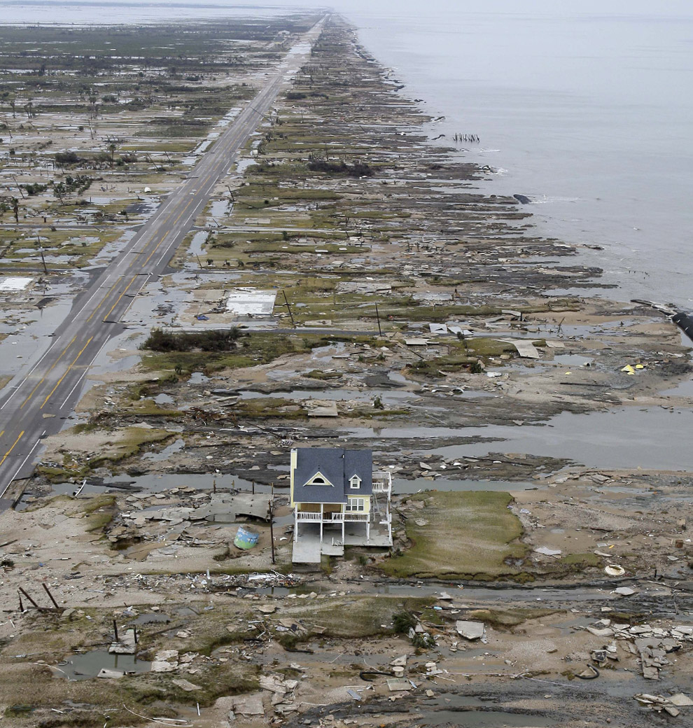
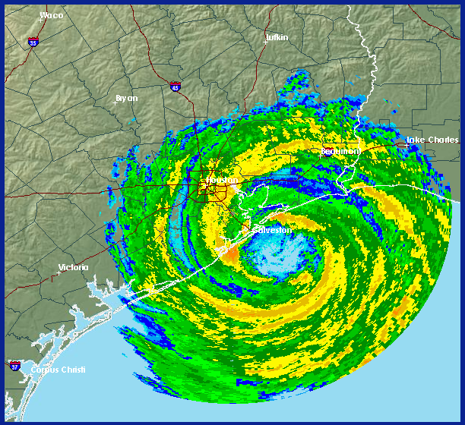
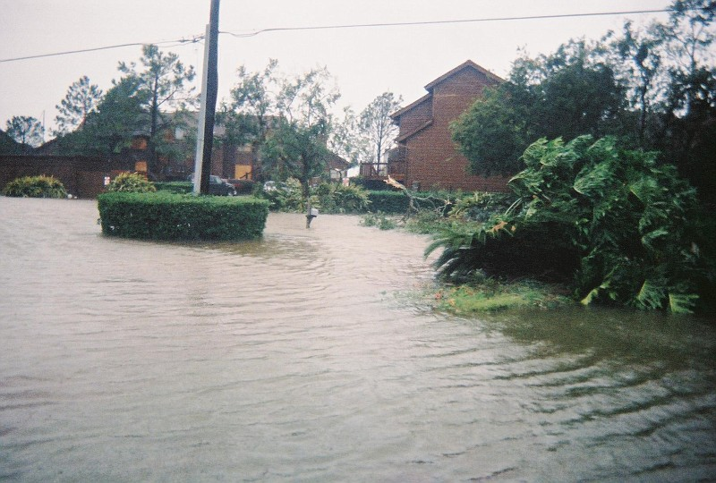
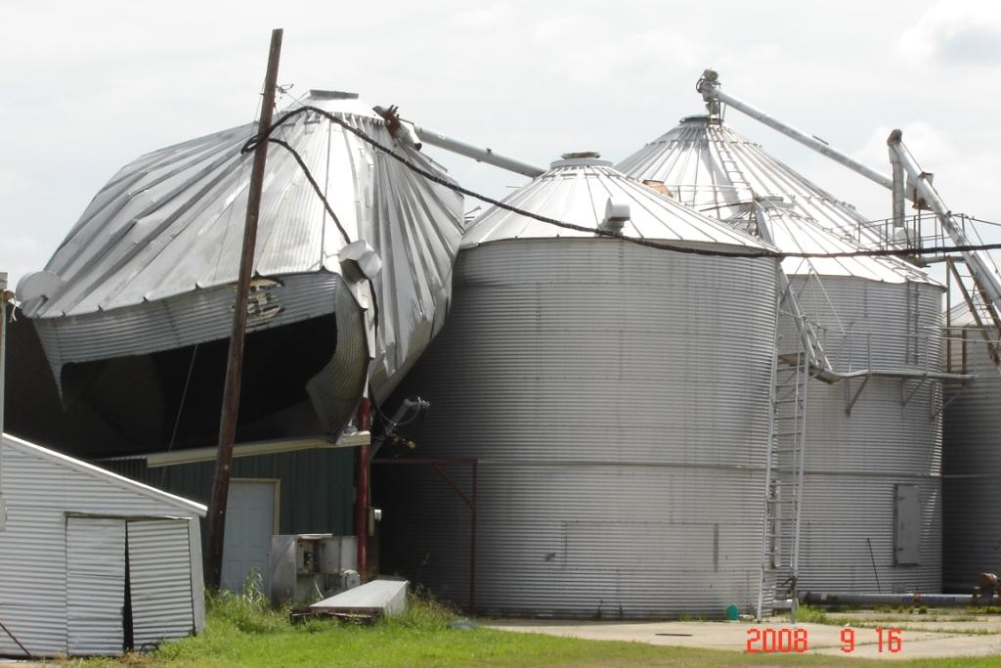
Notes:
Damage to the agriculture along TX gulf coast by hurricane Ike, 2008.

Slide 24
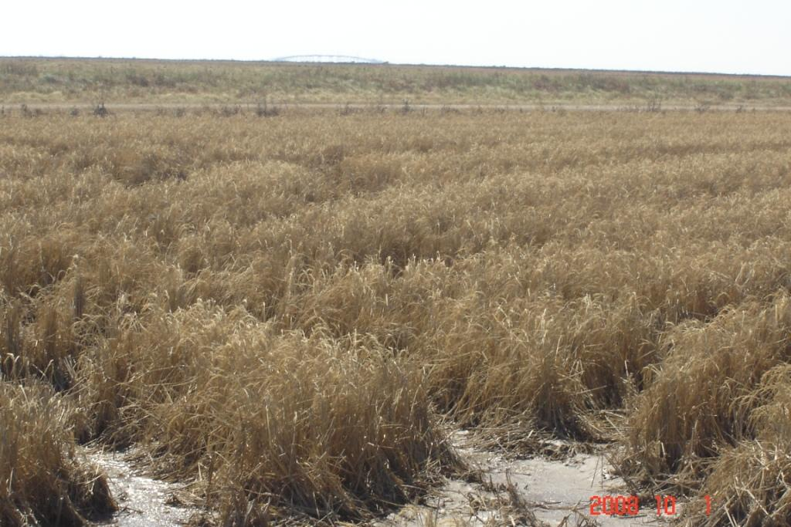
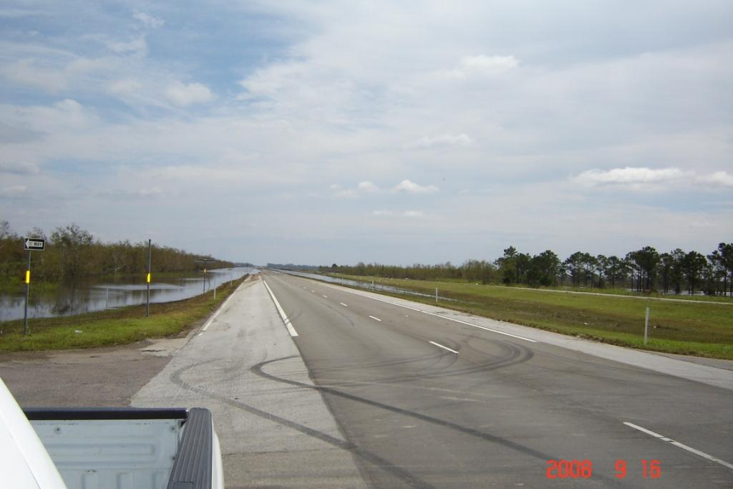
Saline surges wipe out second rice crop at TX and LA shores but this is only start of the problem
Storm surge brings in salt water
Drought leaves it in place
High pumping cost reduces options for flushing soil
Notes:
I choose to show-case salt-tolerance study today as we have just been hit by hurricane Ike on this facility and many rice farmers around the area report damage. Although first rice crop was already harvested, the ratoon crop was completely wiped out by saline surge. But this is only beginning of the problem…Many farmers are devastated and worry if they can plant rice next year in saline soil and rice is pretty much the only crop they can grow on these low land soils…

Slide 25
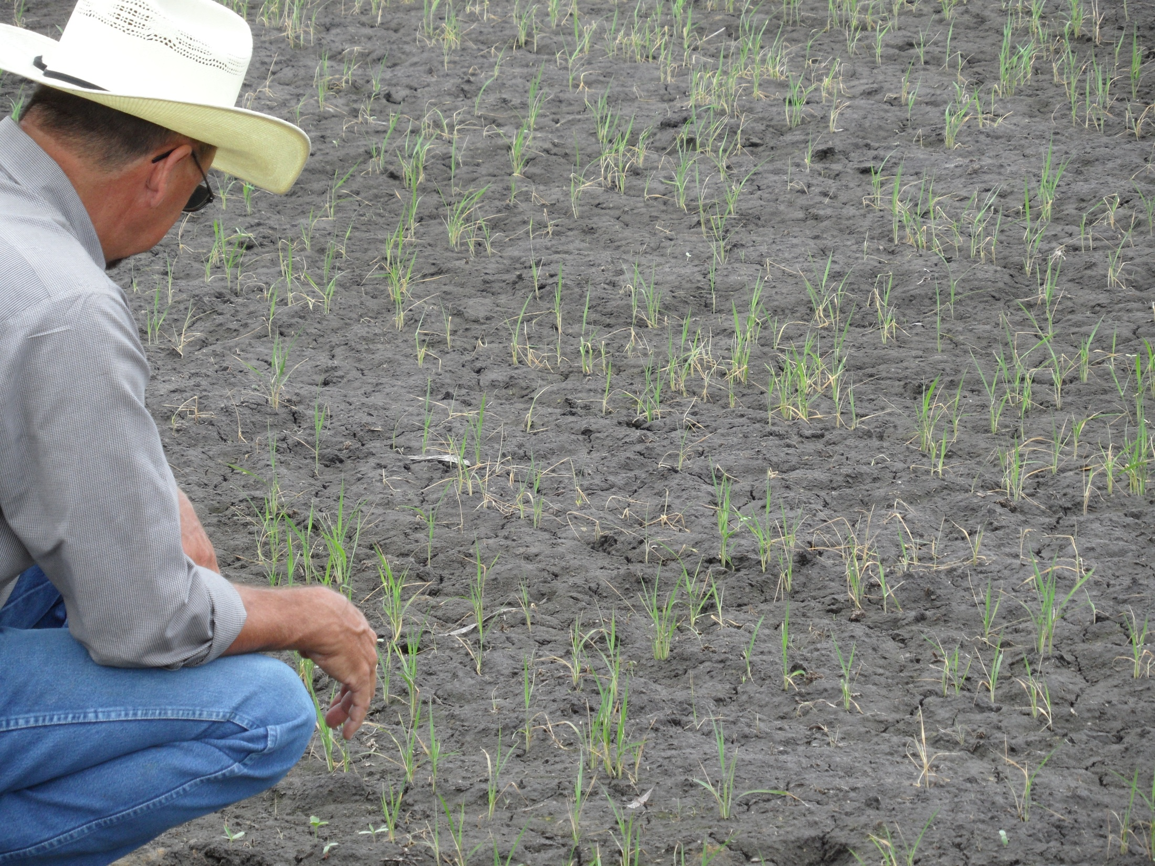
7 years after Rita,
4 year after Ike
No salts are visible, but rice seedlings die

Slide 26
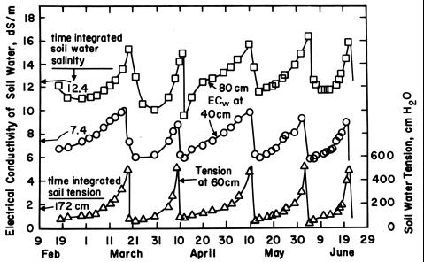
Soil Salinity is highly dynamic
Spatial variability
Temporal variability
Many samples are needed to characterize a single field.

Slide 27
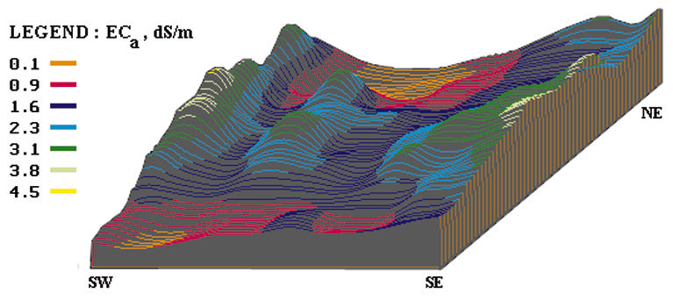
Soil Salinity is influenced by
management practices
water table depths
soil properties
evapotranspiration rates
rainfalls
salinity levels of groundwater
hydrogeological conditions

Slide 28
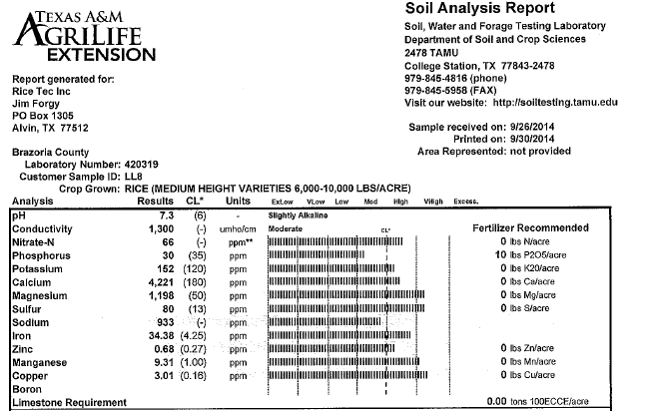
Soil Sampling Frustration
Speed of turn-over
Units
Techniques – results non-comparable between different labs
1000 umho/cm = 1 dS/m = 10 Ohm m = 1/ 640 ppm = 0.64 g/L = 0.064% = 45.7 grains per gallon

Slide 29
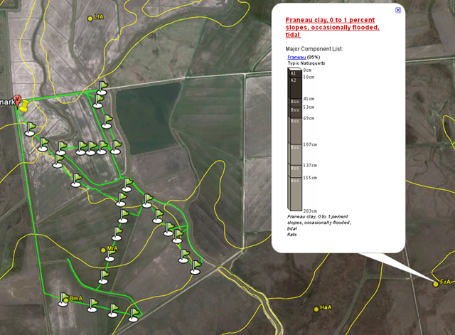
Mapping farm fields GPS

Slide 30
Lab EC correlates with field EC

Slide 31
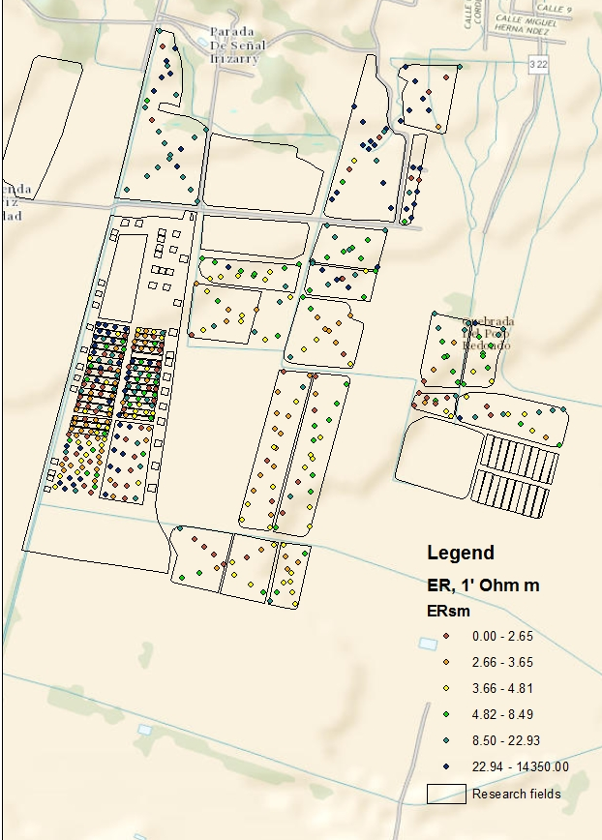
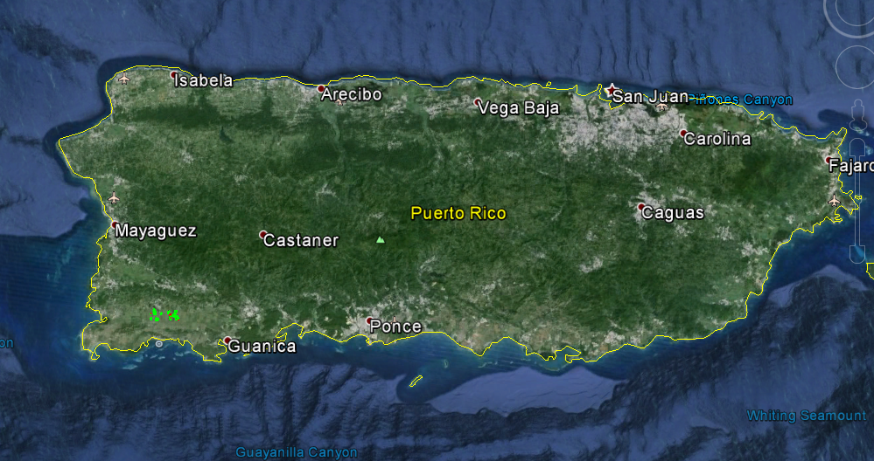
Rice in Puerto-Rico
910 acres research farm
426 points ER measured at 1’ and 2’ depth
2 days, 2 LandMappers, 3 people, AT vehicle (mule)

Slide 32
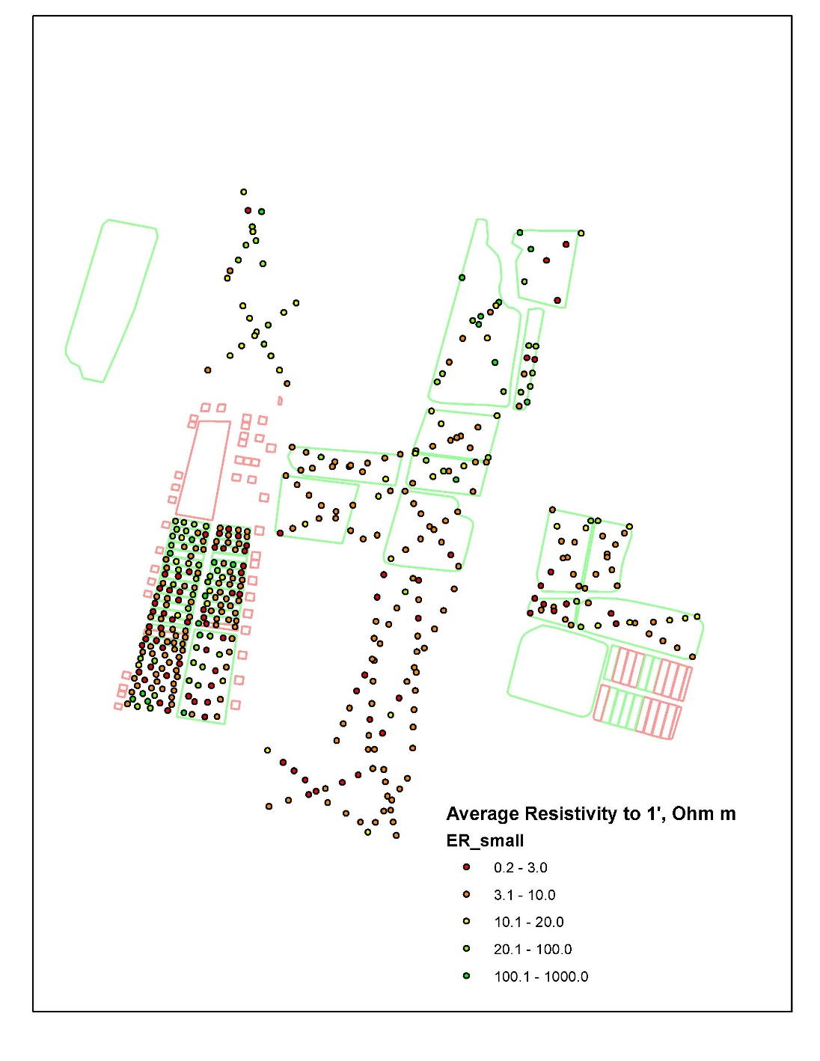
Flexible survey layout
More dense measurements in problem fields
Cross-scanning other fields
Collecting samples from areas of very low/high resistivity

Slide 33
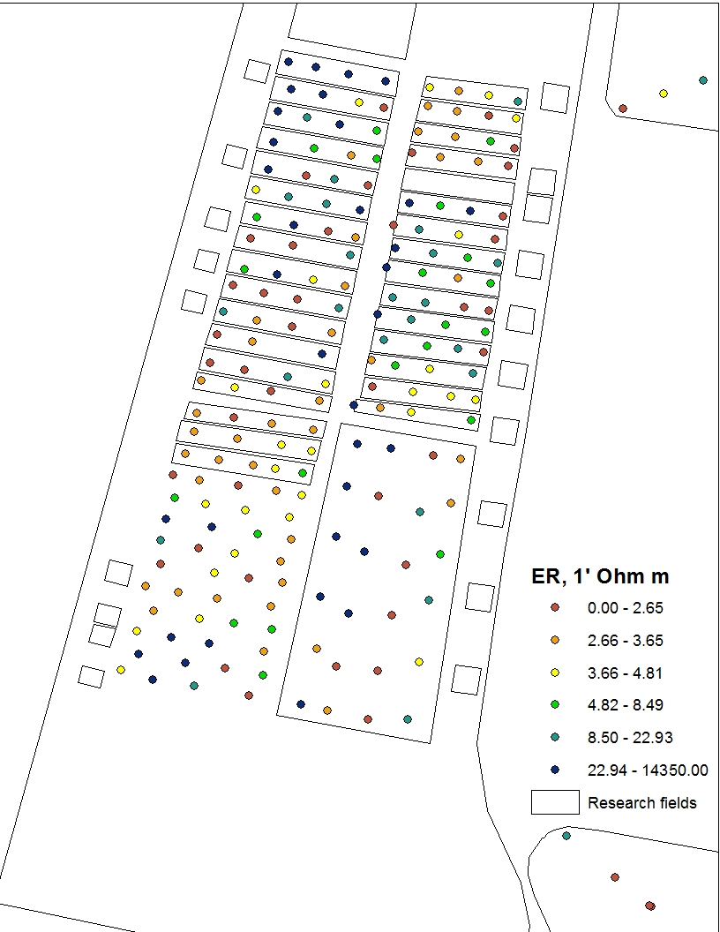
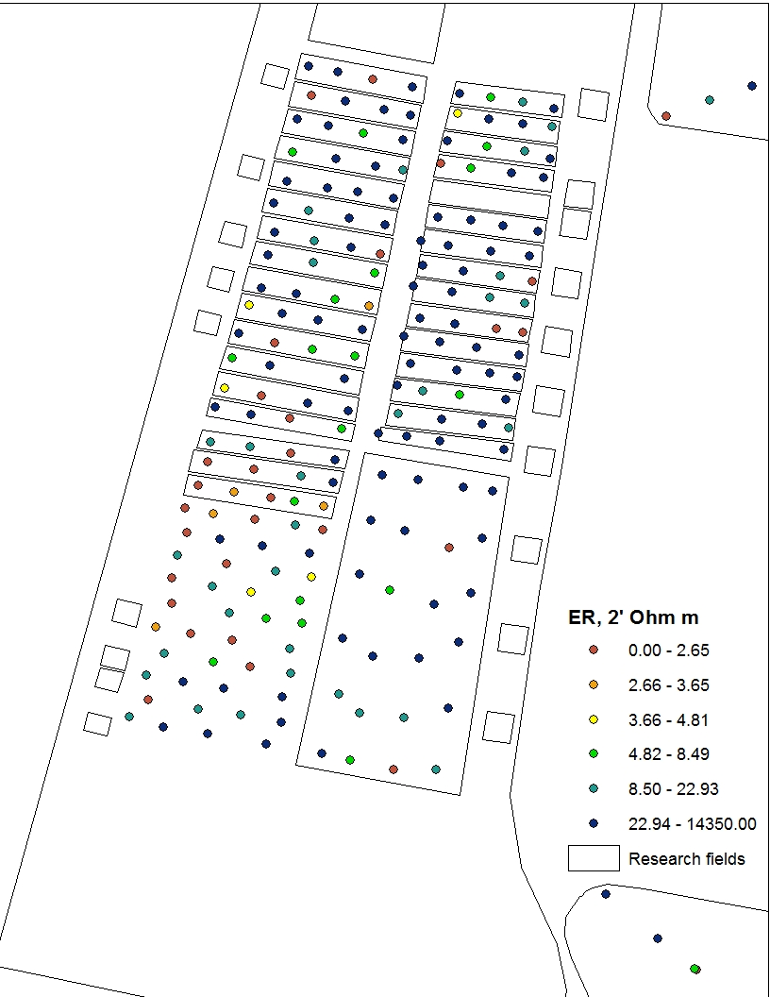
Two layers comparison
Top: bad, deep: non-salty
Top: bad, deep: salty

Slide 34
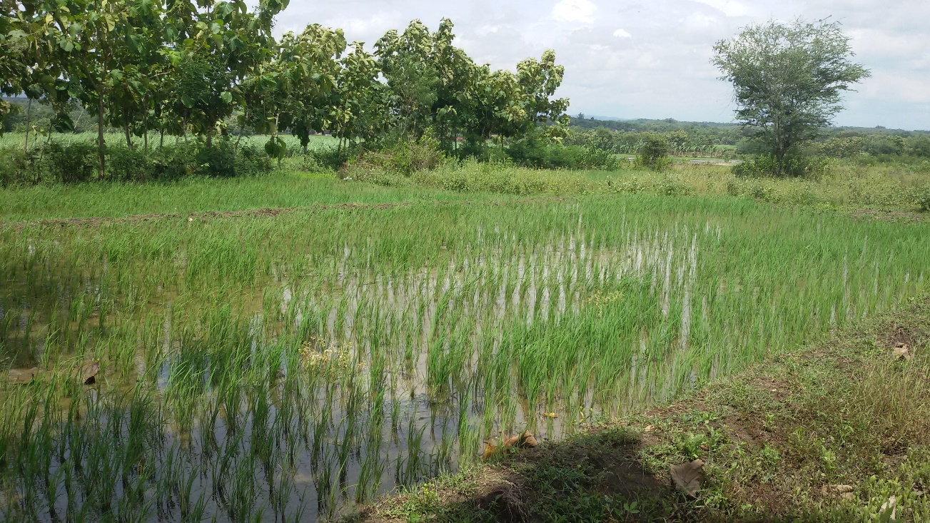
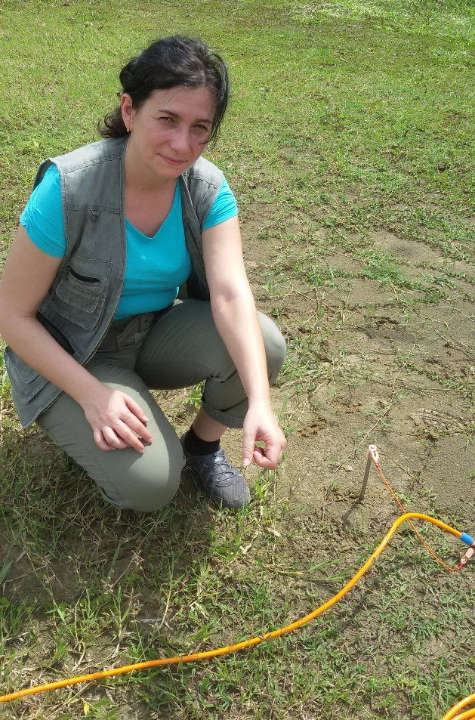
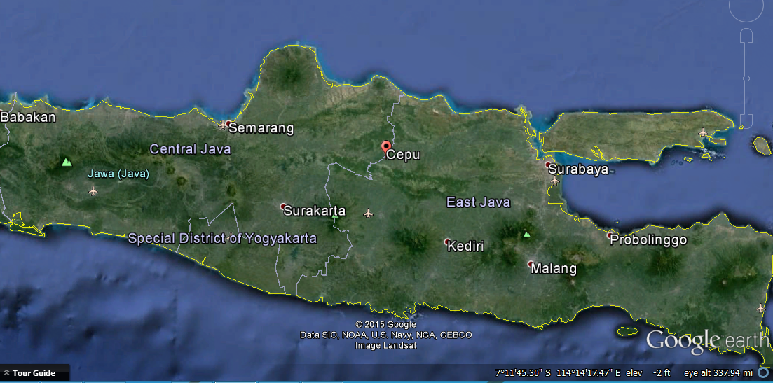
Rice in Indonesia

Slide 35




2D Resistivity Tomography

Slide 36
Rice salinity management guidelines
Good soil EC in top 30 cm < 1.5 dS/m (ER > 6 Ohm m) measured in flooded or “mud” conditions
EC of irrigation water <1 dS/m (ER > 10 Ohm m) – no yield reduction
EC of irrigation water 1-3 dS/m (ER=3-10 Ohm m) – yield reduction up to 50%
On marginally salty soils/water:
  delay permanent flood - use several flushing with fresh water instead, reduce N fertilizer, apply some gypsum on sodic soil pre-season, consider switching to other crops or rice hybrids

Slide 37


Farmer DYI flyer

Slide 38



Thank You
USA Farmers (James Gentz, Jim White, David Murrel, Mr. Saltzman, Mr. Goulding).
RiceTec Inc. (Derrol Grimes, Robert Miller, Mark Spilman, Jose Plaza, Jaime Suarez) & Helena Chemicals (Ronnie Melancor)
Russian Visiting Scientists (Alexey Rusakov, Anatoly Pozdnyakov)
Indonesian STEM Oil and Gas University, Cepu, Central Java)
www.landviser.net

